Slide 1

SCSA1501 - OPERATING SYSTEM
UNIT – 2
PROCESS MANAGEMENT
Dr. B. Ankayarkanni
Dr. A. Mary Posonia
Dept. of CSE
School of Computing

Slide 2
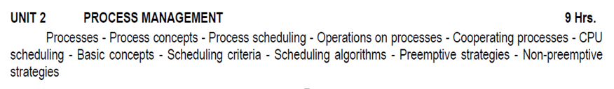
SYLLABUS

Slide 3
INTRODUCTION TO PROCESSES
Early computer systems allowed only one program to be executed at a time.
This program had complete control of the system and had access to all the system’s resources.
In contrast, contemporary computer systems allow multiple programs to be loaded into memory and executed concurrently.
This evolution required firmer control and more compartmentalization of the various programs.
These needs resulted in the notion of a process, which is a program in execution.
A process is the unit of work in a modern computing system.

Slide 4
INTRODUCTION TO PROCESSES
Definition : A process is defined as an entity which represents the basic unit of work to be implemented in the system.
A process is basically a program in execution. The execution of a process must progress in a sequential fashion.
A process will need certain resources—such as CPU time, memory, files, and I/O devices —to accomplish its task.

Slide 5
Traditionally a process contained only a single thread of control as it ran, most modern operating systems now support processes that have multiple threads.
The more complex the operating system is, the more it is expected to do on behalf of its users.
Systems consist of a collection of processes:
Operating-system processes execute system code,
User processes execute user code.
All these processes can execute concurrently, with the CPU (or CPUs)multiplexed among them.

Slide 6
PROCESS
A process is mainly a program in execution where the execution of a process must progress in a sequential order or based on some priority or algorithms.
In other words, it is an entity that represents the fundamental working that has been assigned to a system.
The status of the current activity of a process is represented by the value of the program counter and the contents of the processor’s registers.
When a program gets loaded into the memory, it is said to as process.

Slide 7
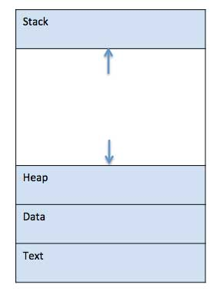
PROCESSES
The memory layout of a process is divided into multiple sections:
Text section—the executable code
Data section—global variables
Heap section—memory that is dynamically allocated during program run time.
Stack section—temporary data storage when invoking functions (such as function parameters, return addresses, and local variables)
Layout of a process in memory

Slide 8
PROCESSES
Process memory is divided into four sections for efficient working :
Text section is made up of the compiled program code, read in from non-volatile storage when the program is launched.
Data section is made up the global and static variables, allocated and initialized prior to executing the main.
Heap is used for the dynamic memory allocation, and is managed via calls to new, delete, malloc, free, etc.
Stack is used for local variables. Space on the stack is reserved for local variables when they are declared.

Slide 9
The sizes of the text and data sections are fixed, as their sizes do not change during program run time.
The stack and heap sections can shrink and grow dynamically during program execution.
Each time a function is called, an activation record containing function parameters, local variables, and the return address is pushed onto the stack; when control is returned from the function, the activation record is popped from the stack.
Similarly, the heap will grow as memory is dynamically allocated, and will shrink when memory is returned to the system.
Although the stack and heap sections grow toward one another, the operating system must ensure they do not overlap one another.

Slide 10
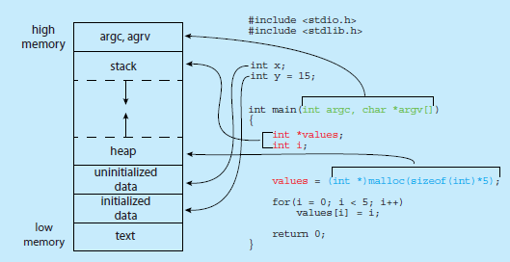
Memory Layout of a C program

Slide 11
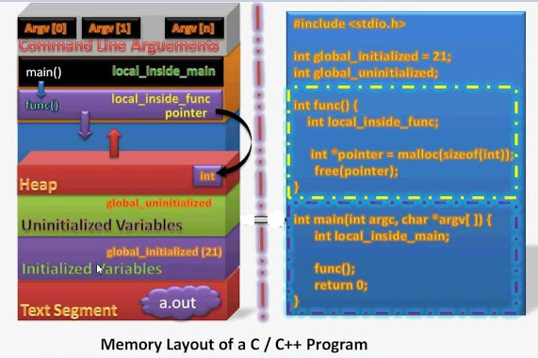

Slide 12
PROCESS CONCEPTS
A question that arises in discussing operating systems involves what to call all the CPU activities.
A batch system executes jobs, whereas a time-shared system has user programs, or tasks.
Even on a single-user system such as Microsoft Windows, a user may be able to run several programs at one time: a word processor, a web browser, and an e-mail package.

Slide 13
What is a Process?
A process is a program in execution.
Process is not as same as program code but a lot more than it.
A process is an 'active' entity as opposed to program which is considered to be a 'passive' entity.
Attributes held by process include hardware state, memory, CPU etc.

Slide 14
PROCESS CONCEPTS
A process includes:
Counter
Program stack
Data section
The current activity, as represented by the value of the program counter and the contents of the processor's registers.
The process stack contains temporary data (such as function parameters, return addresses, and local variables)
A data section, which contains global variables.
Process may also include a heap, which is memory that is dynamically allocated during process run time.

Slide 15
Process vs Program
Process | Program
The process is basically an instance of the computer program that is being executed. | A Program is basically a collection of instructions that mainly performs a specific task when executed by the computer.
A process has a shorter lifetime. | A Program has a longer lifetime.
A Process requires resources such as memory, CPU, Input-Output devices. | A Program is stored by hard-disk and does not require any resources.
A process has a dynamic instance of code and data. | A Program has static code and static data.
Basically, a process is the running instance of the code. | On the other hand, the program is the executable code.

Slide 16
PROCESS STATE
As a process executes, it changes state. The state of a process is defined as by the current activity of that process.
These states may differ in different operating systems, and the names of these states are also not standardized.
The state of a process may change due to events like I/O requests, interrupt routines, synchronization of processes, process scheduling algorithms, etc.

Slide 17
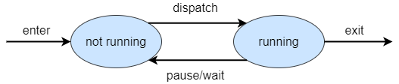
Two State Process Model:
Not-running State: Process waiting for execution.
Running State: Process currently executing.
When a process is first created by the OS, it initializes the program control block for the process and the new process enters the system in Not-running state.

Slide 18
The currently running process will be interrupted by some events, and the OS will move the currently running process from Running state to Not-running state.
The dispatcher then selects one process from Not-running processes and moves the process to the Running state for execution.
When a process finishes the execution, the process exits the system and the dispatcher again selects a new process and moves it to Running state.
All the processes in the Not-running state are maintained in a queue.

Slide 19
Three State Process Model:
One major drawback of two state process model is when dispatcher brings a new process from not-running state to running state, the process might still be waiting for some event or I/O request.
So, the dispatcher must traverse the queue and find a not-running process that is ready for execution. It can degrade performance.

Slide 20
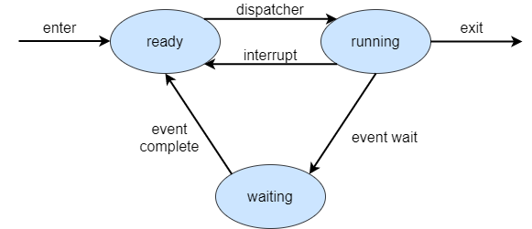
Three State Process Model:
To overcome this problem, we split the not-running state into two states: Ready State and Waiting (Blocked) State.
Ready State: The process in the main memory that is ready for execution.
Waiting or Blocked State: The process in the main memory that is waiting for some event.

Slide 21
Five State Process Model
In general, a process can have one of the following five states at a time.
New: The process is being created.
Running: Instructions are being executed.
Waiting: The process is waiting for some event to occur (such as an I/O completion or reception of a signal).
Ready: The process is waiting to be assigned to a processor.
Terminated: The process has finished execution.

Slide 22
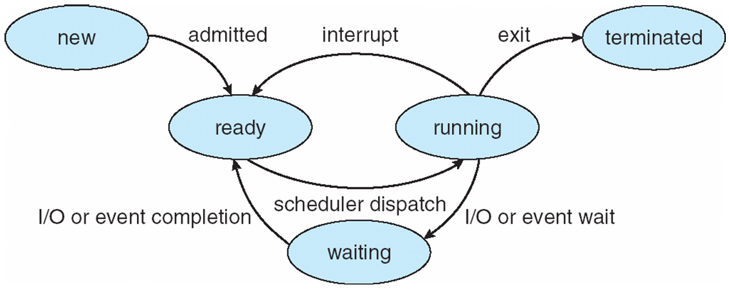
DIAGRAM OF PROCESS STATE / PROCESS LIFE CYCLE

Slide 23
PROCESS STATE
START / NEW
This is the initial state when a process is first started / created.
READY
The process is waiting to be assigned to a processor.
Ready processes are waiting to have the processor allocated to them by the operating system so that they can run.
Process may come into this state after Start state or while running it ,get interrupted by the scheduler to assign CPU to some other process.
RUNNING
Once the process has been assigned to a processor by the OS scheduler, the process state is set to running and the processor executes its instructions.

Slide 24
PROCESS STATE
WAITING
Process moves into the waiting state if it needs to wait for a resource, such as waiting for user input, or waiting for a file to become available.
TERMINATED OR EXIT
Once the process finishes its execution, or it is terminated by the operating system, it is moved to the terminated state where it waits to be removed from main memory.
These names are arbitrary, and they vary across operating systems.

Slide 25
Six State Process Model
Since, the processor is much faster than I/O devices., a situation may occur where the processor executes so fast that all of the processes move to waiting state and no process is in ready state.
The CPU sits idle until atleast one process finishes the I/O operation. This leads to low CPU utilization.
To prevent this, if all the processes in the main memory are in waiting state, the OS suspends a process in waiting/blocked state and move it to secondary memory. The process is now in suspend state. This is known as swapping.
All suspend processes are kept in a queue. The memory of the swapped process is freed.

Slide 26
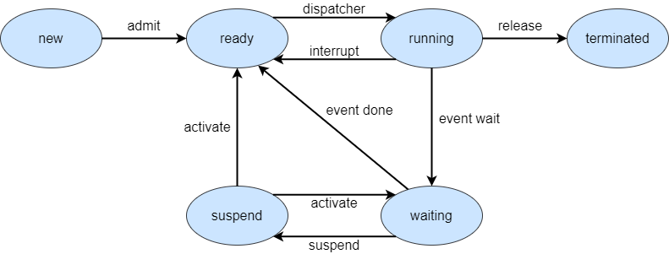
CPU can now bring some other process in the main memory. There are two options:
First is to bring a brand new process and the second option is to bring another process from suspend queue back to main memory. Bringing a process from the suspend queue is preferred.
Notes:
You may be wondering swapping process to secondary memory is also I/O operation so it should degrade performance? Yes, it should but disk I/O operations are generally the fastest I/O operations. Thus, it enhances performance.

Slide 27
Seven State Process Model
The CPU doesn’t know which process in the suspend queue is ready for execution.
CPU may swap a process that is still waiting for event completion from secondary memory back to the main memory. There is no point in moving a blocked process back to the main memory. The performance suffers.
To avoid this, we divide the suspend state into 2 states:
Blocked/Suspend: The process is in secondary memory but not yet ready for execution.
Ready/Suspend: The process is in secondary memory and ready for execution.

Slide 28
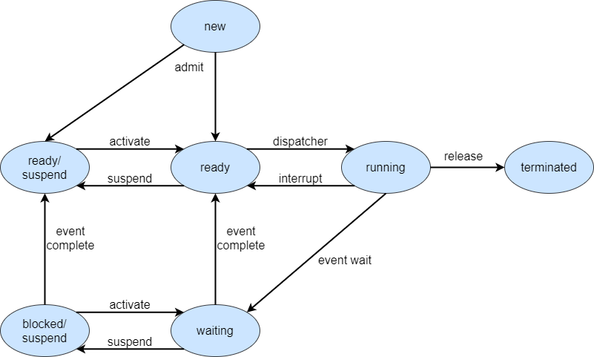
Seven State Process Model

Slide 29
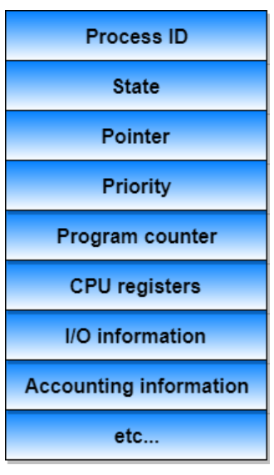
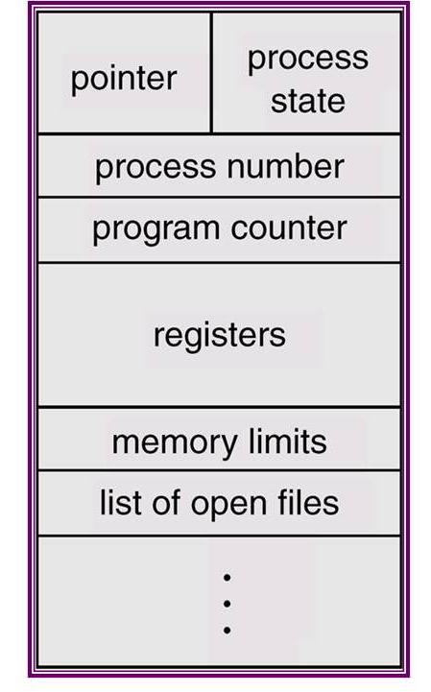
PROCESS CONTROL BLOCK (PCB)
Information associated with each process (also called task control block)

Slide 30
PCB
There is a Process Control Block for each process, enclosing all the information about the process. It is a data structure, which contains the following:
Process State
The state may be new, ready, running, waiting, halted, and so on.
Process Privileges
This is required to allow/disallow access to system resources.
Process ID
Unique identification for each of the process in the operating system.

Slide 31
PCB
Pointer
A pointer to parent process.
Program Counter
Program Counter is a pointer to the address of the next instruction to be executed for this process.
CPU Registers
The registers vary in number and type, depending on the computer architecture. They include accumulators, index registers, stack pointers and general purpose registers, plus any condition code information.
Along with the program counter, this state information must be saved when an interrupt occurs, to allow the process to be continued correctly afterward.

Slide 32
PCB
CPU Scheduling Information
This information includes a process priority, pointers to scheduling queues and any other scheduling parameters.
Memory Management Information
This information may include such information as the value of the base and limit registers, the page tables or the segment tables, depending on the memory system used by the OS.
Accounting Information
This information includes the amount of CPU and real-time used, time limits, account numbers, job or process numbers and so on.
IO Status Information
This information includes the list of I/O devices allocated to the process, a list of open files and so on.

Slide 33
PCB
The architecture of a PCB is completely dependent on Operating System and may contain different information in different operating systems.
The PCB is maintained for a process throughout its lifetime, and is deleted once the process terminates.

Slide 34
CONTEXT SWITCH
Switching the CPU to another process requires saving the state of the old process and loading the saved state for the new process. This task is known as a Context Switch.
The context of a process is represented in the Process Control Block(PCB) of a process; it includes the value of the CPU registers, the process state and memory-management information.

Slide 35
It is one of the essential features of the multitasking operating system.
The processes are switched so fastly that it gives an illusion to the user that all the processes are being executed at the same time.
Context switch time is pure overhead, because the system does no useful work while switching. Its speed varies from machine to machine, depending on the memory speed.

Slide 36
Context switching can happen due to the following reasons:
When a process of high priority comes in the ready state. In this case, the execution of the running process should be stopped and the higher priority process should be given the CPU for execution.
When an interruption occurs then the process in the running state should be stopped and the CPU should handle the interrupt before doing something else.
When a transition between the user mode and kernel mode is required then you have to perform the context switching.

Slide 37
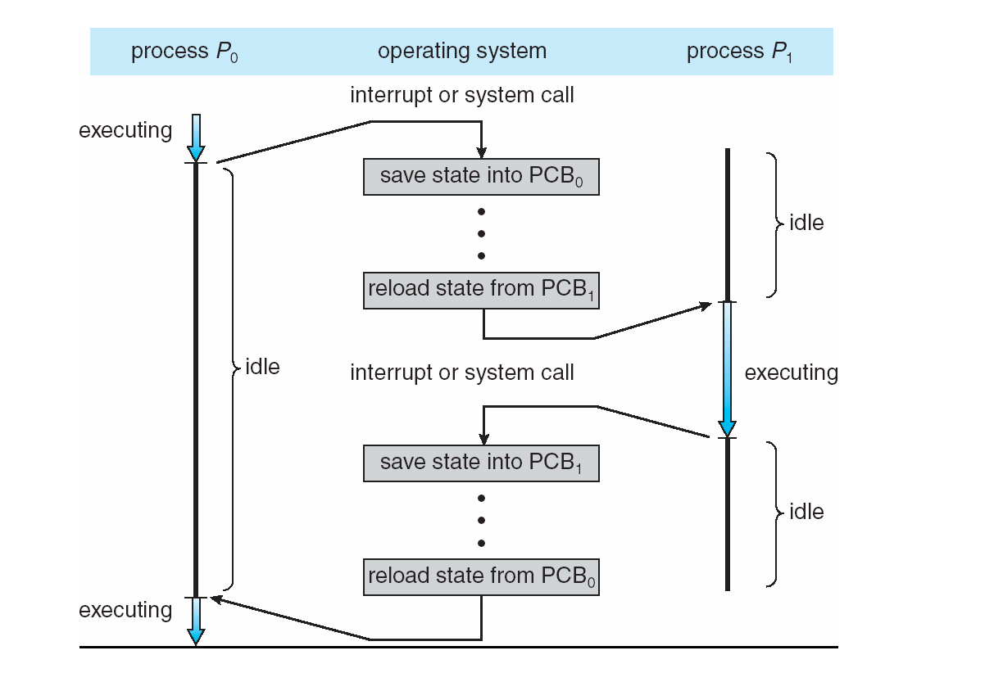

Slide 38
The process P1 is in the running state and the process P2 is in the ready state.
When some interruption occurs then you have to switch the process P1 from running to the ready state after saving the context and the process P2 from ready to running state.
The following steps will be performed:
The context of the process P1 i.e. the process present in the running state will be saved in the Process Control Block of process P1 i.e. PCB1.
Move the PCB1 to the relevant queue i.e. ready queue, I/O queue, waiting queue, etc.
From the ready state, select the new process that is to be executed i.e. the process P2.

Slide 39
Update the Process Control Block of process P2
i.e. PCB2 by setting the process state to running. If the process P2 was earlier executed by the CPU, then you can get the position of last executed instruction so that you can resume the execution of P2.
Similarly, if we want to execute the process P1 again, then follow the same steps from step 1 to 4.
The time involved in the context switching of one process by other is called the Context Switching Time.

Slide 40
PROCESS SCHEDULING
The objective of multiprogramming is to have some process running at all times so as to maximize CPU utilization.
The objective of time sharing is to switch a CPU core among processes so frequently that users can interact with each program while it is running.
Each CPU core can run one process at a time.
To meet these objectives, the process scheduler selects an available process (possibly from a set of several available processes) for program execution on a core.

Slide 41
PROCESS SCHEDULING
The act of determining which process is in the ready state, and should be moved to the running state is known as Process Scheduling.
AIM : The process scheduling system is to keep the CPU busy all the time and to deliver minimum response time for all programs.
For achieving this, the scheduler must apply appropriate rules for swapping processes IN and OUT of CPU.

Slide 42
PROCESS SCHEDULING
For a system with a single CPU core, there will never be more than one process running at a time,
Whereas a multicore system can run multiple processes at one time.
If there are more processes than cores, excess processes will have to wait until a core is free and can be rescheduled.
The number of processes currently in memory is known as the degree of multiprogramming.

Slide 43
Balancing the objectives of multiprogramming and time sharing also requires taking the general behavior of a process into account.
In general, most processes can be described as either I/O bound or CPU bound.
An I/O-bound process is one that spends more of its time doing I/O than it spends doing computations.
A CPU-bound process, in contrast, generates I/O requests infrequently, using more of its time doing computations.

Slide 44
Scheduling Queues
All processes, upon entering into the system, are stored in the Job Queue.
Processes in the Ready state are placed in the Ready Queue.
Processes waiting for a device to become available are placed in Device Queues. There are unique device queues available for each I/O device.
The OS maintains all PCBs in Process Scheduling Queues.
The OS maintains a separate queue for each of the process states and PCBs of all processes in the same execution state are placed in the same queue.

Slide 45
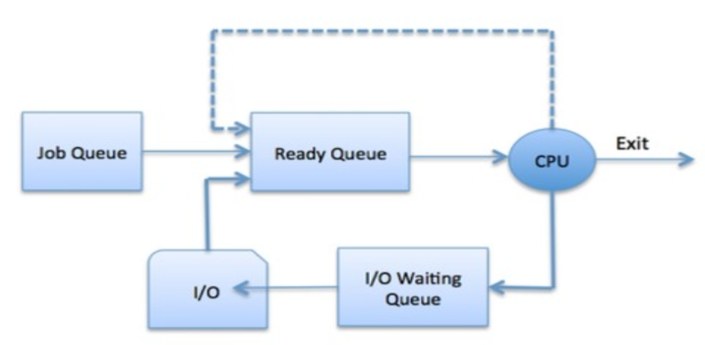
Scheduling Queues?
The OS can use different policies to manage each queue (FIFO, Round Robin, Priority, etc.)

Slide 46
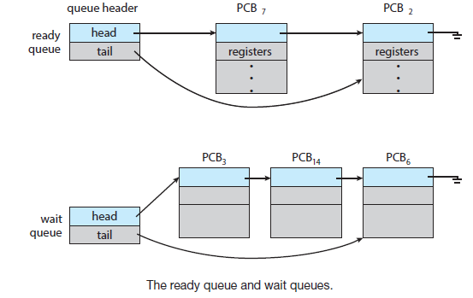

Slide 47
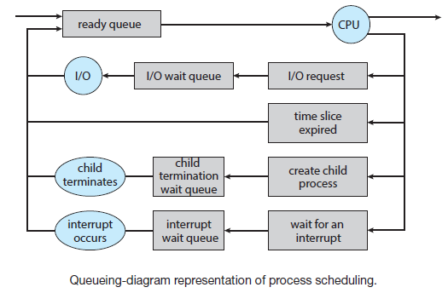
QUEUING DIAGRAM REPRESENTATION FOR PROCESS SCHEDULING

Slide 48
Scheduling Queues
A new process is initially put in the ready queue. It waits there until it is selected for execution, or dispatched.
Once the process is assigned to the CPU and is executing, one of the following several events can occur:
The process could issue an I/O request, and then be placed in the I/O queue.
The process could create a new child process and then be placed in a wait queue while it awaits the child’s termination.
The process could be removed forcibly from the CPU, as a result of an interrupt or having its time slice expire, and be put back in the ready queue.

Slide 49
SCHEDULERS
Schedulers are special system software which handles the process scheduling in various ways.
Their main task is to select the jobs to be submitted into the system and to decide which process to run.
Schedulers are of three types –
Long-Term Scheduler
Short-Term Scheduler
Medium-Term Scheduler

Slide 50
LONG TERM SCHEDULER
It is also called a job scheduler.
A long-term scheduler determines which programs are admitted to the system for processing.
It selects processes from the queue and loads them into memory for execution.
Process loads into the memory for CPU scheduling.

Slide 51
SHORT TERM SCHEDULER
It is also called as CPU scheduler.
Its main objective is to increase system performance in accordance with the chosen set of criteria.
It is the change of ready state to running state of the process.
CPU scheduler selects a process among the processes that are ready to execute and allocates CPU to one of them.
Short-term schedulers, also known as dispatchers, make the decision of which process to execute next.

Slide 52
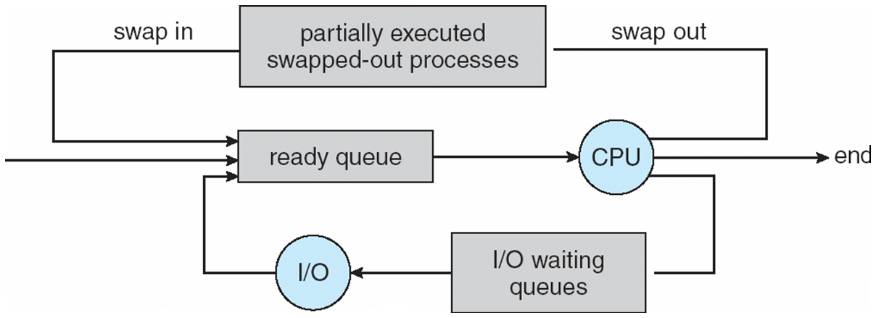
MEDIUM TERM SCHEDULER
Medium-term scheduling is a part of swapping.
It removes the processes from the memory.
The medium-term scheduler is in-charge of handling the swapped out-processes.

Slide 53
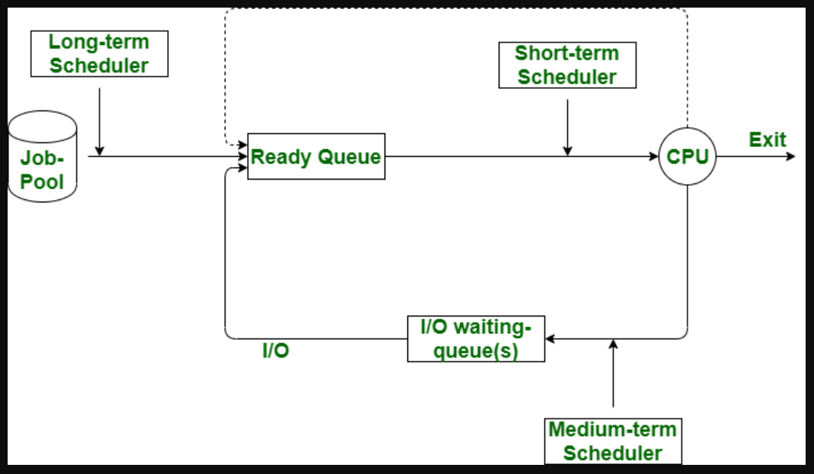

Slide 54
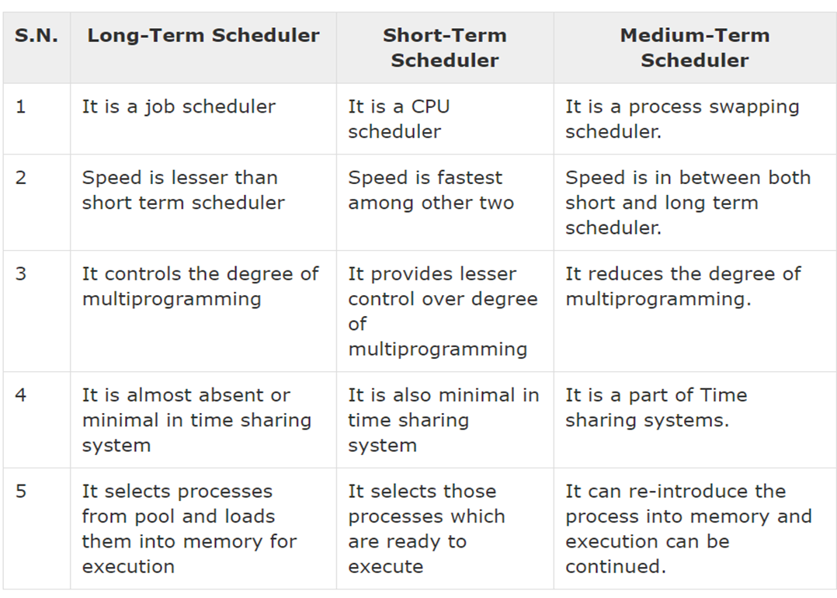

Slide 55
Short-term scheduler (or CPU scheduler) – selects which process should be executed next and allocates CPU
Sometimes the only scheduler in a system
Short-term scheduler is invoked frequently (milliseconds) ⇒ (must be fast)
Long-term scheduler (or job scheduler) – selects which processes should be brought into the ready queue
Long-term scheduler is invoked infrequently (seconds, minutes) ⇒ (may be slow)
The long-term scheduler controls the degree of multiprogramming
Processes can be described as either:
I/O-bound process – spends more time doing I/O than computations, many short CPU bursts
CPU-bound process – spends more time doing computations; few very long CPU bursts
Long-term scheduler strives for good process mix

Slide 56
OPERATIONS ON PROCESSES
The processes in the system can execute concurrently, and they must be created and deleted dynamically.
The two major operation Process Creation and Process Termination.

Slide 57
PROCESS CREATION
Through appropriate system calls, such as fork or spawn, processes may create other processes.
The creating process is called a parent process, and the new processes are called the children of that process.
Each of these new processes may in turn create other processes, forming a tree of processes.
Generally, process identified and managed via a process identifier (pid).

Slide 58
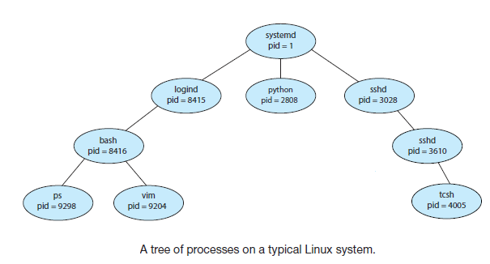

Slide 59
PROCESS CREATION
When a process creates a new process, two possibilities for execution exist:
Parent and children execute concurrently.
Parent waits until children terminate.
There are also two address-space possibilities for the new process:
The child process is a duplicate of the parent process (it has the same program and data as the parent).
The child process has a new program loaded into it.
Resource sharing
Parent and children share all resources.
Children share subset of parent’s resources.
Parent and child share no resources.

Slide 60
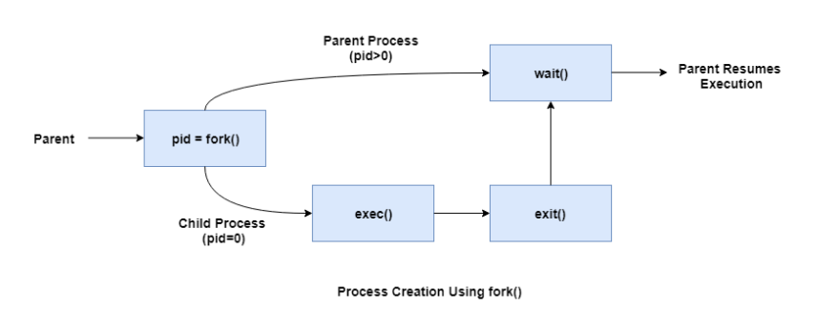
PROCESS CREATION

Slide 61
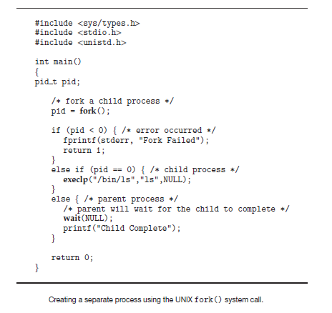

Slide 62
PROCESS TERMINATION
Process executes last statement and then asks the operating system to delete it using the exit() system call.
Returns status data from child to parent (via wait())
Process resources are deallocated by operating system
Parent may terminate the execution of children processes using the abort() system call. Some reasons for doing so:
Child has exceeded allocated resources.
Task assigned to child is no longer required.
The parent is exiting and the operating systems does not allow a child to continue if its parent terminates.

Slide 63
PROCESS TERMINATION
Some systems do not allow a child to exist if its parent has terminated.
In such systems, if a process terminates (either normally or abnormally), then all its children must also be terminated.
This phenomenon, referred to as cascading termination, is normally initiated by the operating system.

Slide 64
COOPERATING PROCESSES
Processes executing concurrently in the operating system may be either independent processes or cooperating processes.
A process is independent if it does not share data with any other processes executing in the system.
A process is cooperating if it can affect or be affected by the other processes executing in the system. Clearly, any process that shares data with other processes is a cooperating process.
There are several reasons for providing an environment that allows process cooperation:
Information Sharing
Computation Speedup
Modularity
Convenience
Buffer

Slide 65
COOPERATING PROCESSES
Information Sharing:
Since several users may be interested in the same piece of information (for instance, a shared file), we must provide an environment to allow concurrent access to such information.
Computation Speedup:
If we want a particular task to run faster, we must break it into subtasks, each of which will be executing in parallel with the others.
Notice that such a speedup can be achieved only if the computer has multiple processing cores.

Slide 66
COOPERATING PROCESSES
Modularity:
We may want to construct the system in a modular fashion, dividing the system functions into separate processes or threads.
Convenience:
There are many tasks that a user needs to do such as compiling, printing, editing etc. It is convenient if these tasks can be managed by cooperating processes.

Slide 67
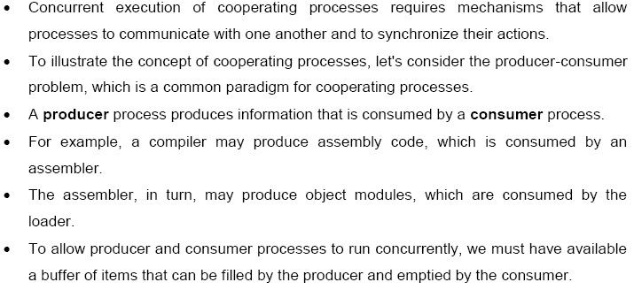

Slide 68
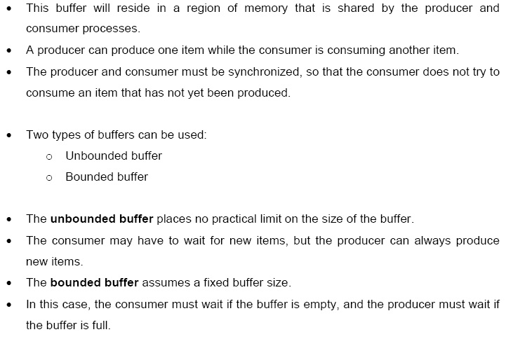

Slide 69
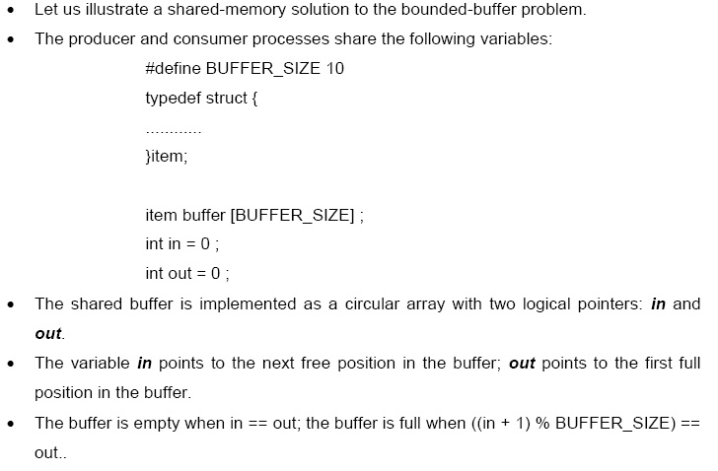

Slide 70
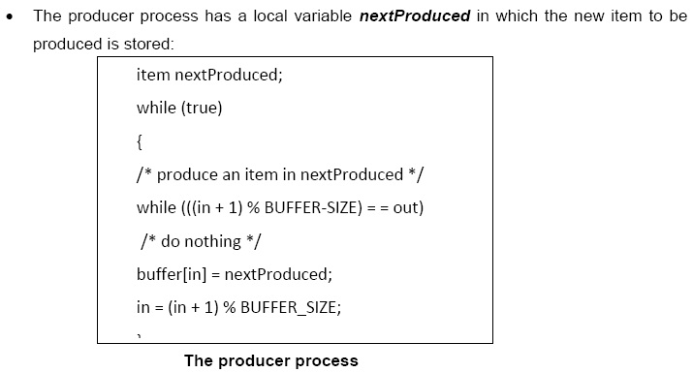

Slide 71
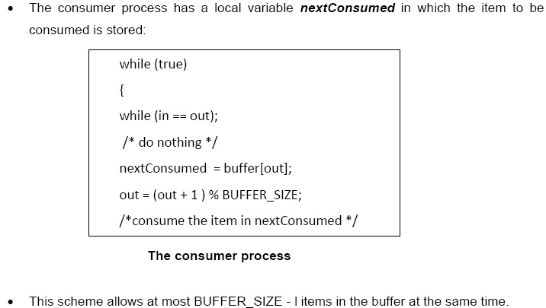

Slide 72
Buffering
Whether communication is direct or indirect, messages exchanged by communicating processes reside in a temporary queue. Basically, such queues can be implemented in three ways:
Zero capacity: The queue has a maximum length of zero; thus, the link cannot have any messages waiting in it. In this case, the sender must block until the recipient receives the message.
Bounded capacity: The queue has finite length n; thus, atmost n messages can reside in it. If the queue is not full when a new message is sent, the message is placed in the queue (either the message is copied or a pointer to the message is kept), and the sender can continue execution without waiting. If the link is full, the sender must block until space is available in the queue.

Slide 73
Unbounded capacity: The queue’s length is potentially infinite; thus, any number of messages can wait in it. The sender never blocks.
The zero-capacity case is sometimes referred to as a message system with no buffering. The other cases are referred to as systems with automatic buffering.

Slide 74
Cooperating processes require an interprocess communication (IPC) mechanism that will allow them to exchange data— that is, send data to and receive data from each other. There are two fundamental models of interprocess communication:
shared memory and
message passing
In the shared-memory model, a region of memory that is shared by the cooperating processes is established. Processes can then exchange information by reading and writing data to the shared region.
In the message-passing model, communication takes place by means of messages exchanged between the cooperating processes.

Slide 75
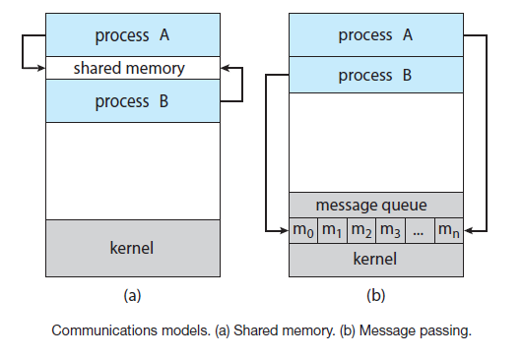

Slide 76
CPU SCHEDULING
CPU scheduling is a process which allows one process to use the CPU while the execution of another process is on hold(in waiting state)
This is due to unavailability of any resource like I/O etc, thereby making full use of CPU.
The aim of CPU scheduling is to make the system efficient, fast and fair.
Whenever the CPU becomes idle, the operating system must select one of the processes in the ready queue to be executed.

Slide 77
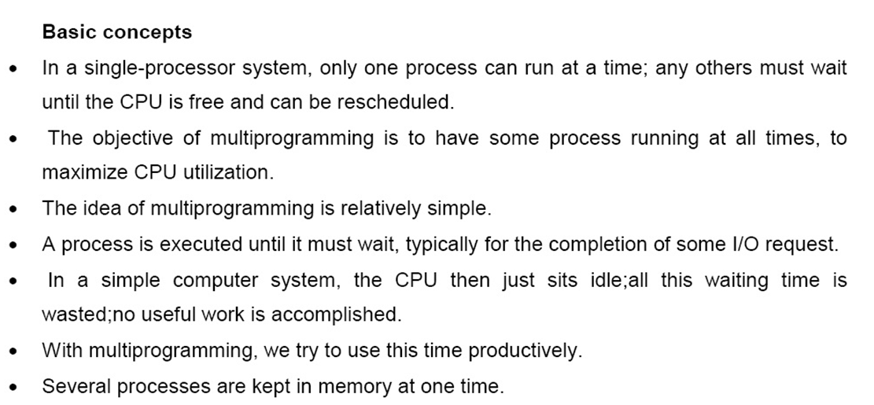

Slide 78
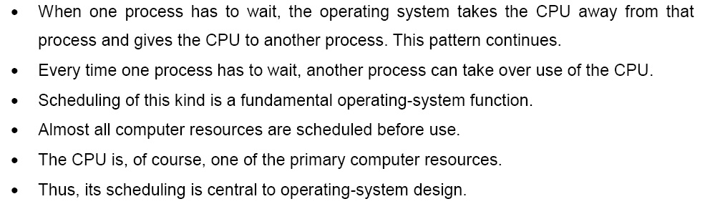

Slide 79
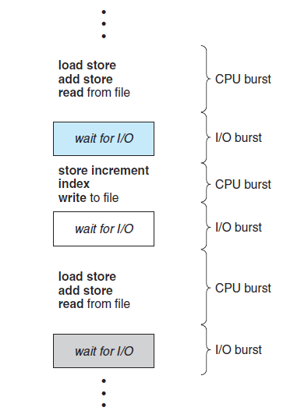
Alternating sequence of CPU and I/O bursts

Slide 80
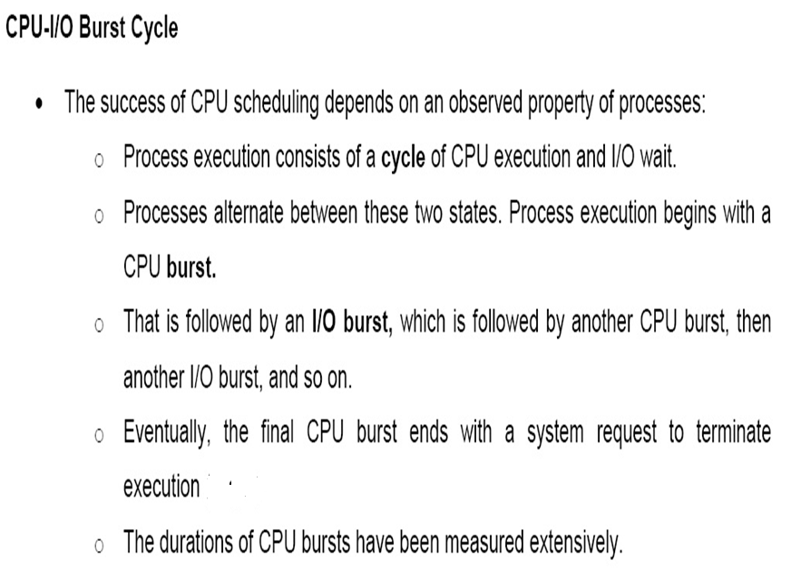

Slide 81
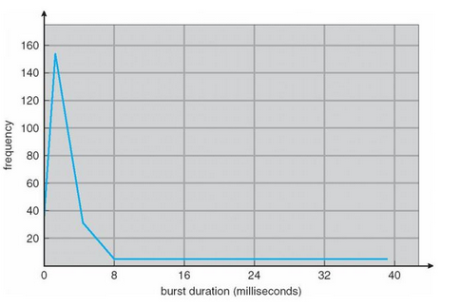
CPU burst vary greatly from process to process and from computer to computer, they tend to have a frequency curve.
The curve is generally characterized as exponential or hyper exponential, with a large number of short CPU bursts and a small number of long CPU bursts.
An I/O-bound program typically has many short CPU bursts. A CPU-bound program might have a few long CPU bursts. This distribution can be important when implementing a CPU-scheduling algorithm.

Slide 82
CPU SCHEDULING
CPU Scheduling decision may take place when a process:
switches from the running state to the waiting state (for I/O request or invocation of wait for the termination of one of the child processes).
switches from the running state to the ready state (for example, when an interrupt occurs).
switches from the waiting state to the ready state (for example, completion of I/O).
When a process terminates.

Slide 83
CPU SCHEDULING: DISPATCHER
The main component involved in the CPU scheduling function is the Dispatcher.
The dispatcher is the module that gives control of the CPU to the process selected by the short-term scheduler.
This function involves:
Switching context
Switching to user mode
Jumping to the proper location in the user program to restart that program from where it left last time.
The dispatcher should be as fast as possible, given that it is invoked during every process switch.
The time taken by the dispatcher to stop one process and start another process is known as the Dispatch Latency.

Slide 84
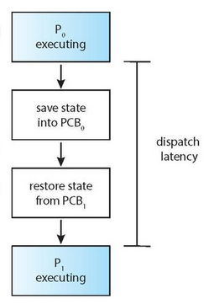

Slide 85
CPU SCHEDULING: SCHEDULING CRITERIA
Different CPU scheduling algorithms have different properties, and the choice of a particular algorithm may favor one class of processes over another.
Many criteria have been suggested for comparing CPU scheduling algorithms.
Which characteristics are used for comparison can make a substantial difference in which algorithm is judged to be best.
CPU Utilization
Throughput
Turnaround Time
Waiting Time
Load Average
Response Time

Slide 86
CPU SCHEDULING: SCHEDULING CRITERIA
CPU UTILIZATION
We want to keep the CPU as busy as possible.
Conceptually, CPU utilization can range from 0 to 100 percent.
In a real system, it should range from 40 percent (for a lightly loaded system) to 90 percent (for a heavily loaded system).
THROUGHPUT
If the CPU is busy executing processes, then work is being done.
One measure of work is the number of processes that are completed per time unit, called throughput.
For long processes, this rate may be one process over several seconds; for short transactions, it may be tens of processes per second.

Slide 87
CPU SCHEDULING: SCHEDULING CRITERIA
TURNAROUND TIME
From the point of view of a particular process, the important criterion is how long it takes to execute that process.
The interval from time of submission of the process to the time of completion of the process .
Turnaround time is the sum of the periods spent waiting in the ready queue, executing on the CPU, and doing I/O.
Turnaround Time = Burst Time + Waiting Time
Turnaround Time = Completion Time — Arrival Time

Slide 88
CPU SCHEDULING: SCHEDULING CRITERIA
WAITING TIME
The CPU-scheduling algorithm does not affect the amount of time during which a process executes or does I/O.
It affects only the amount of time that a process spends waiting in the ready queue.
Waiting time is the sum of the periods spent waiting in the ready queue.
LOAD AVERAGE
It is the average number of processes residing in the ready queue waiting for their turn to get into the CPU.

Slide 89
CPU SCHEDULING: SCHEDULING CRITERIA
RESPONSE TIME
In an interactive system, turnaround time may not be the best criterion.
Often, a process can produce some output fairly early and can continue computing new results while previous results are being output to the user.
Thus, another measure is the time from the submission of a request until the first response is produced.
This measure, called response time, is the time it takes to start responding, not the time it takes to output the response.

Slide 90
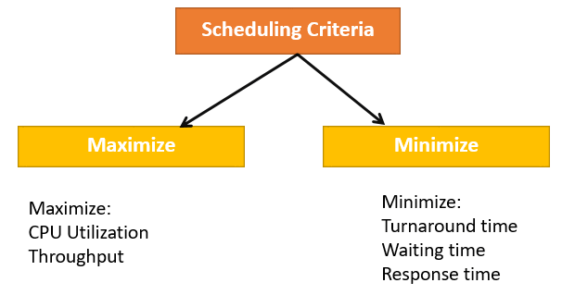
CPU Scheduling Criteria
A CPU scheduling algorithm tries to maximize and minimize the following:

Slide 91
CPU SCHEDULING
CPU Scheduling decision may take place when a process:
switches from the running state to the waiting state (for I/O request or invocation of wait for the termination of one of the child processes).
switches from the running state to the ready state (for example, when an interrupt occurs).
switches from the waiting state to the ready state (for example, completion of I/O).
When a process terminates.

Slide 92
Preemptive Scheduling | Non-Preemptive Scheduling
Resources are allocated according to the cycles for a limited time. | Resources are used and then held by the process until it gets terminated.
The process can be interrupted, even before the completion. | The process is not interrupted until its life cycle is complete.
Starvation may be caused, due to the insertion of priority process in the queue. | Starvation can occur when a process with large burst time occupies the system.
Maintaining queue and remaining time needs storage overhead. | No such overheads are required.
In preemptive scheduling, CPU utilization is high. | It is low in non preemptive scheduling.
Examples of preemptive scheduling are Round Robin and Shortest Remaining Time First. | Examples of non-preemptive scheduling are First Come First Serve and Shortest Job First.

Slide 93
SCHEDULING ALGORITHMS
CPU scheduling deals with the problem of deciding which of the processes in the ready queue is to be allocated the CPU.
There are many different CPU scheduling algorithms:
First Come First Serve (FCFS) Scheduling
Shortest-Job-First (SJF) Scheduling
Priority Scheduling
Shortest Remaining Time (SRT) Scheduling
Round Robin (RR) Scheduling
Multilevel Queue Scheduling
Multilevel Feedback Queue Scheduling

Slide 94
COMMON DEFINITIONS INVOLVED IN CALCULATION PROCES
ARRIVAL TIME: Time taken for the arrival of each process in the CPU Scheduling Queue.
BURST TIME : The amount of time required by a process for executing on CPU. It is also called as execution time or running time.
COMPLETION TIME: Time taken for the execution to complete, starting from arrival time.
TURN AROUND TIME: Time taken to complete after arrival. In simple words, it is the difference between the Completion time and the Arrival time.
WAITING TIME: Total time the process has to wait before it's execution begins. It is the difference between the Turn Around time and the Burst time of the process.

Slide 95
FCFS - FIRST COME FIRST SERVE SCHEDULING
In the "First come first serve" scheduling algorithm, as the name suggests, the process which arrives first, gets executed first.
We can say that the process which requests the CPU first, gets the CPU allocated first.
It is a non-preemptive.
Its implementation is based on FIFO queue.
When a process enters the ready queue, its PCB is linked onto the tail of the queue.
When the CPU is free, it is allocated to the process at the head of the queue.
The running process is then removed from the queue.

Slide 96
Characteristics:
1. It is easy to implement.
2. CPU is always allotted on the basis of First-come and First-serve.
3. But, this algorithm is poor in performance as the average waiting time is quite high.

Slide 97
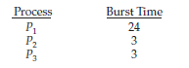
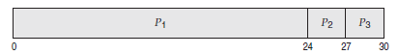
Problem -1
Consider the following set of processes that arrive at time 0, with the length of the CPU burst given in milliseconds:
If the processes arrive in the order P1, P2, P3, and are served in FCFS order, we get the result shown in the following Gantt chart.
Gantt chart is a bar chart that illustrates a particular schedule, including the start and finish times of each of the participating processes.

Slide 98
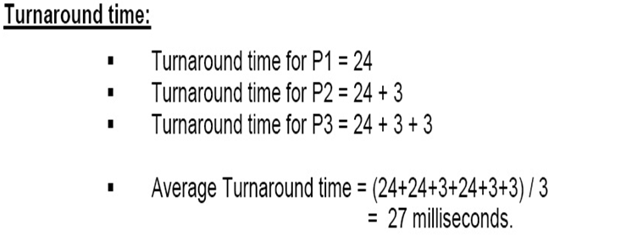
The waiting time is
0 milliseconds for process P1.
24 milliseconds for process P2.
27 milliseconds for process P3.
Thus, the average waiting time is
(0 + 24 + 27)/3 = 17 milliseconds.

Slide 99
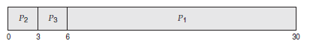
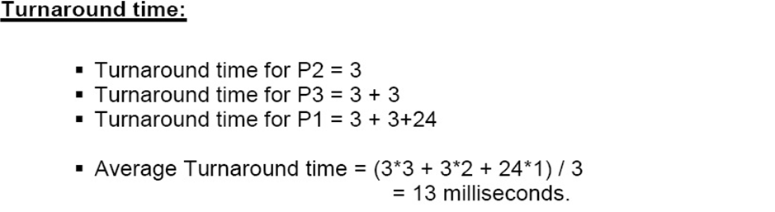
If the processes arrive in the order P2, P3, P1, the results will be as shown in the following Gantt chart:
The average waiting time is:
(6 + 0 + 3)/3 = 3 milliseconds

Slide 100
Problems with FCFS Scheduling
It is Non Pre-emptive algorithm, which means the process priority doesn't matter.
If a process with very least priority is being executed, more like daily routine backup process, which takes more time, and all of a sudden some other high priority process arrives, like interrupt to avoid system crash, the high priority process will have to wait, and hence in this case, the system will crash, just because of improper process scheduling.
Not optimal Average Waiting Time.
Resources utilization in parallel is not possible, which leads to Convoy Effect, and hence poor resource(CPU, I/O etc) utilization.
What is Convoy Effect?
Convoy Effect is a situation where many processes, who need to use a resource for short time are blocked by one process holding that resource for a long time.

Slide 101
Problem-2
Processes | Burst time | Waiting time | Turn around time
P1 | 21
P2 | 3
P3 | 6
P4 | 2

Slide 102
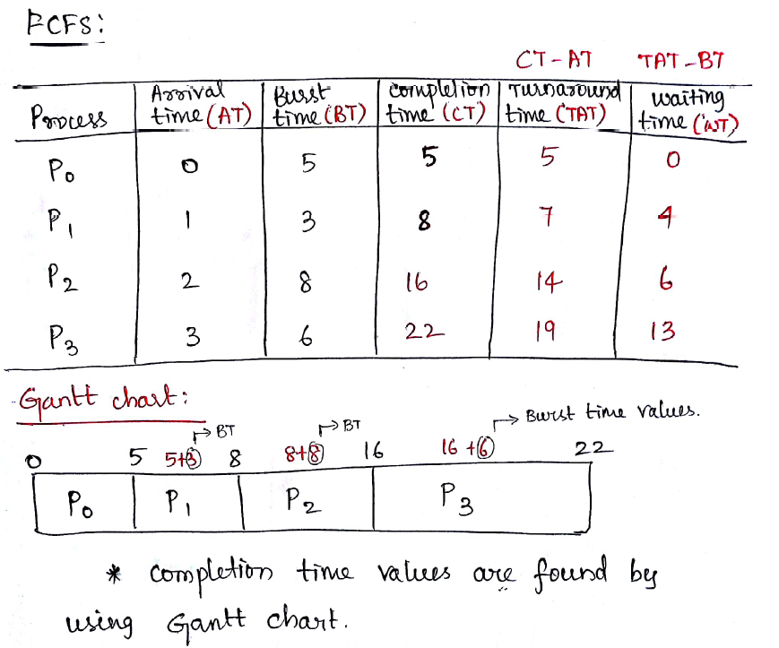
EXAMPLE

Slide 103
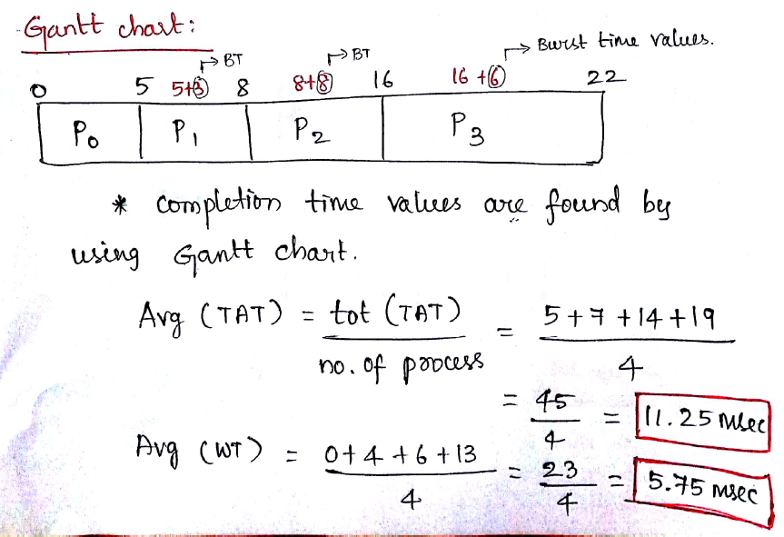

Slide 104
Problem-3
Process | AT | BT | ST | CT | TAT | WT | RT
P1 | 3 | 2
P2 | 2 | 1
P3 | 3 | 2
P4 | 4 | 3
P5 | 5 | 4
Gantt Chart for FCFS Scheduling

Slide 105
SJF – SHORTEST JOB FIRST SCHEDULING
This is also known as shortest job next, or SJN
This is a non-preemptive, pre-emptive scheduling algorithm.
Best approach to minimize waiting time.
Easy to implement in Batch systems where required CPU time is known in advance.
Impossible to implement in interactive systems where required CPU time is not known.
The processer should know in advance how much time process will take.

Slide 106
If the next CPU bursts of two processes are the same, FCFS scheduling is used to break the tie.
Note that a more appropriate term for this scheduling method would be the shortest-next-CPU-burst algorithm, because scheduling depends on the length of the next CPU burst of a process, rather than its total length.
The SJF algorithm can be either preemptive or non-preemptive.
The choice arises when a new process arrives at the ready queue while a previous process is still executing. The next CPU burst of the newly arrived process may be shorter than what is left of the currently executing process.

Slide 107
A preemptive SJF algorithm will preempt the currently executing process, whereas a non-preemptive SJF algorithm will allow the currently running process to finish its CPU burst.
Preemptive SJF scheduling is sometimes called shortest-remaining time- first scheduling.

Slide 108
Advantages of SJF
Maximum throughput
Minimum average waiting and turnaround time
Disadvantages of SJF
May suffer with the problem of starvation
It is not implementable because the exact Burst time for a process can't be known in advance.

Slide 109
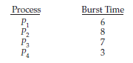
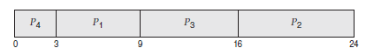
Problem -1
Consider the following set of processes that arrive at time 0, with the length of the CPU burst given in milliseconds:
Using SJF scheduling, we would schedule these processes according to the following Gantt chart:

Slide 110
Problem -1
The waiting time is:
3 milliseconds for process P1
16 milliseconds for process P2
9 milliseconds for process P3
0 milliseconds for process P4
The average waiting time is (3 + 16 + 9 + 0)/4 = 7 milliseconds.
By comparison, if we were using the FCFS scheduling scheme, the average waiting time would be 10.25 milliseconds.

Slide 111
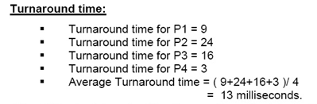
The SJF scheduling algorithm is provably optimal, it gives the minimum average waiting time for a given set of processes.
Moving a short process before a long one decreases the waiting time of the short process more than it increases the waiting time of the long process.
Consequently, the average waiting time decreases.

Slide 112
Problem -2
Consider the processes P1, P2, P3, P4 and P5. Their arrival time and burst time are given in the table below. (Non-preemptive SJF)
PID | Arrival Time | Burst Time | Completion Time | Turn Around Time | Waiting Time
1 | 1 | 7
2 | 3 | 3
3 | 6 | 2
4 | 7 | 10
5 | 9 | 8

Slide 113
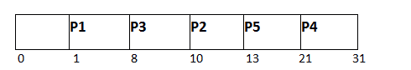
Problem -2
Consider the processes P1, P2, P3, P4 and P5. Their arrival time and burst time are given in the table below. (Non-preemptive SJF)
PID | Arrival Time | Burst Time | Completion Time | Turn Around Time | Waiting Time
P1 | 1 | 7 | 8 | 7 | 0
P2 | 3 | 3 | 13 | 10 | 7
P3 | 6 | 2 | 10 | 4 | 2
P4 | 7 | 10 | 31 | 24 | 14
P5 | 9 | 8 | 21 | 12 | 4

Slide 114
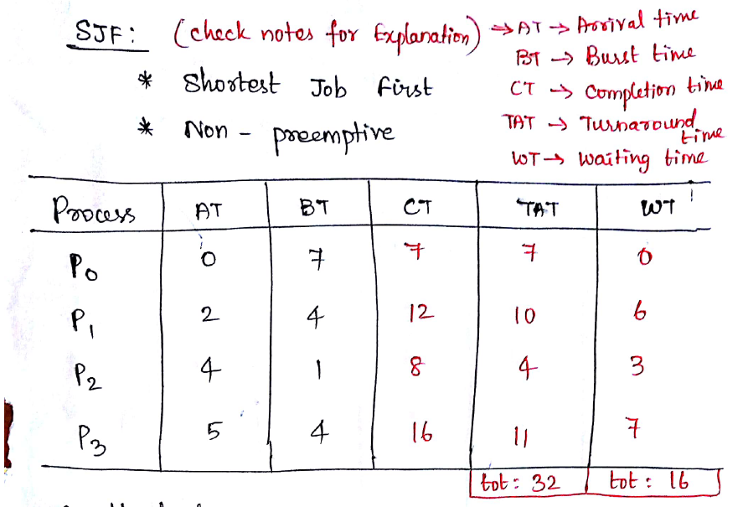

Slide 115
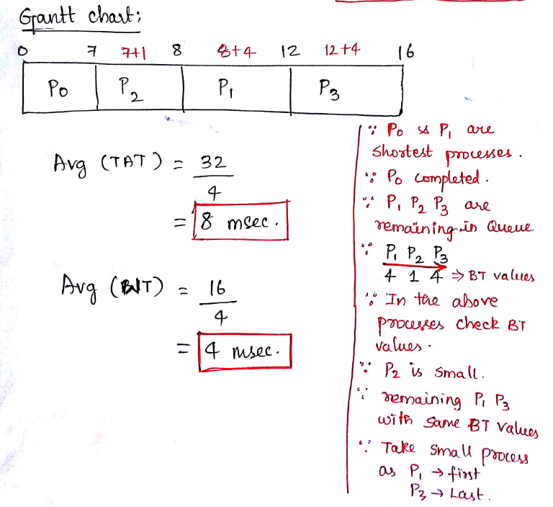

Slide 116
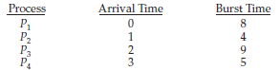
Shortest-Remaining Time- First scheduling(SRTF)
Preemptive SJF scheduling is sometimes called shortest-remaining time- first scheduling.
Consider the following four processes, with the length of the CPU burst given in milliseconds:

Slide 117
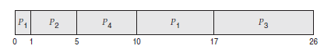
If the processes arrive at the ready queue at the times shown and need the indicated burst times, then the resulting preemptive SJF schedule is as depicted in the following Gantt chart:
PID | Arrival Time | Burst Time | Completion Time | Turn Around Time | Waiting Time
P1 | 0 | 8 | 17 | 17 | 9
P2 | 1 | 4 | 5 | 4 | 0
P3 | 2 | 9 | 26 | 24 | 15
P4 | 3 | 5 | 10 | 7 | 2

Slide 118
SJF vs SRTF
Process ID | Arrival Time(AT) | Burst Time(BT) | Completion Time(CT) | Turn Around Time(TAT) CT-AT | Waiting Time(WT) TAT-BT
P1 | 1 | 7
P2 | 2 | 3
P3 | 3 | 5
P4 | 4 | 4
P5 | 5 | 1

Slide 119
SJF vs SRTF
Process ID | Arrival Time(AT) | Burst Time(BT) | Completion Time(CT) | Turn Around Time(TAT) CT-AT | Waiting Time(WT) TAT-BT
P1 | 1 | 7
P2 | 2 | 3
P3 | 3 | 5
P4 | 4 | 4
P5 | 5 | 1

Slide 120
Priority Scheduling
The SJF algorithm is a special case of the general priority-scheduling algorithm.
A priority is associated with each process, and the CPU is allocated to the process with the highest priority.
Equal-priority processes are scheduled in FCFS order.
An SJF algorithm is simply a priority algorithm where the priority (p) is the inverse of the (predicted) next CPU burst.
The larger the CPU burst, the lower the priority, and vice versa.

Slide 121
Priority Scheduling
Scheduling in terms of high priority and low priority- Priorities are generally indicated by some fixed range of numbers, such as 0 to 7 or 0 to 4,095.
However, there is no general agreement on whether 0 is the highest or lowest priority.
Some systems use low numbers to represent low priority; others use low numbers for high priority.
This difference can lead to confusion.
We assume that low numbers represent high priority.

Slide 122
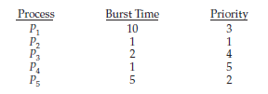

Example-1
Consider the following set of processes, assumed to have arrived at time 0 in the order P1, P2, · · ·, P5, with the length of the CPU burst given in milliseconds:
Using priority scheduling, we would schedule these processes according to the following Gantt chart:

Slide 123



Slide 124
Priorities can be defined either internally or externally.
Internally defined priorities use some measurable quantity or quantities to compute the priority of a process.
For example, time limits, memory requirements, the number of open files, and the ratio of average I/O burst to average CPU burst have been used in computing priorities.
External priorities are set by criteria outside the operating system, such as the importance of the process, the type and amount of funds being paid for computer use, the department sponsoring the work, and other, often political, factors.

Slide 125
Priority scheduling can be either preemptive or non-preemptive.
When a process arrives at the ready queue, its priority is compared with the priority of the currently running process.
A preemptive priority scheduling algorithm will preempt the CPU if the priority of the newly arrived process is higher than the priority of the currently running process.
A non-preemptive priority scheduling algorithm will simply put the new process at the head of the ready queue.

Slide 126
A major problem with priority scheduling algorithms is indefinite blocking, or starvation.
A process that is ready to run but waiting for the CPU can be considered blocked.
A solution to the problem of indefinite blockage of low priority processes is aging.
Aging involves gradually increasing the priority of processes that wait in the system for a long time.

Slide 127


Example-2

Slide 128
Process ID | Arrival Time (AT) | Burst Time(BT) | Priority | Completion Time(CT) | Turn Around Time(TAT) CT-AT | Waiting Time(WT) TAT-BT
P1 | 0 | 11 | 2 | 11 | 11 | 0
P2 | 5 | 28 | 0 | 39 | 34 | 6
P3 | 12 | 2 | 3 | 51 | 39 | 37
P4 | 2 | 10 | 1 | 49 | 47 | 37
P5 | 9 | 16 | 4 | 67 | 58 | 42

Slide 129
Round Robin (RR) Scheduling
The round-robin (RR) scheduling algorithm is similar to FCFS scheduling, but preemption is added to enable the system to switch between processes.
A small unit of time, called a time quantum or time slice, is defined.
A time quantum is generally from 10 to 100 milliseconds in length. The ready queue is treated as a circular queue.
The CPU scheduler goes around the ready queue, allocating the CPU to each process for a time interval of up to 1 time quantum.

Slide 130
To implement RR scheduling, treat the ready queue as a FIFO queue of processes.
New processes are added to the tail of the ready queue.
The CPU scheduler picks the first process from the ready queue, sets a timer to interrupt after 1 time quantum, and dispatches the process.
One of two things will then happen. The process may have a CPU burst of less than 1 time quantum. In this case, the process itself will release the CPU voluntarily.
The scheduler will then proceed to the next process in the ready queue.
If the CPU burst of the currently running process is longer than 1 time quantum, the timer will go off and will cause an interrupt to the operating system.

Slide 131
A context switch will be executed, and the process will be put at the tail of the ready queue. The CPU scheduler will then select the next process in the ready queue.
The average waiting time under the RR policy is often long.

Slide 132


Example-1
Consider the following set of processes that arrive at time 0, with the length of the CPU burst given in milliseconds:
Use a time quantum of 4 milliseconds

Slide 133
Process P1 gets the first 4 milliseconds. Since it requires another 20 milliseconds, it is preempted after the first time quantum, and the CPU is given to the next process in the queue, process P2.
Process P2 does not need 4 milliseconds, so it quits before its time quantum expires. The CPU is then given to the next process, process P3.
Once each process has received 1 time quantum, the CPU is returned to process P1 for an additional time quantum. The resulting RR schedule is as follows:

Slide 134


Slide 135
In the RR scheduling algorithm, no process is allocated the CPU for more than 1 time quantum in a row (unless it is the only runnable process).
If a process’s CPU burst exceeds 1 time quantum, that process is preempted and is put back in the ready queue.
The RR scheduling algorithm is thus preemptive.
The performance of the RR algorithm depends heavily on the size of the time quantum.
At one extreme, if the time quantum is extremely large, the RR policy is the same as the FCFS policy.
In contrast, if the time quantum is extremely small (say, 1 millisecond), the RR approach can result in a large number of context switches.

Slide 136


Slide 137

Multilevel Queue Scheduling
With both priority and round-robin scheduling, all processes may be placed
in a single queue, and the scheduler then selects the process with the highest
priority to run. Depending on how the queues are managed, an O(n) search
may be necessary to determine the highest-priority process. In practice, it is
often easier to have separate queues for each distinct priority, and priority
scheduling simply schedules the process in the highest-priority queue. This
is illustrated in Figure 5.7. This approach—known as multilevel queue—
also works well when priority scheduling is combined with round-robin: if
there are multiple processes in the highest-priority queue, they are executed in
round-robin order. In the most generalized form of this approach, a priority is
assigned statically to each process, and a process remains in the same queue
for the duration of its runtime.

Slide 138

A multilevel queue scheduling algorithm can also be used to partition
processes into several separate queues based on the process type (Figure
5.8). For example, a common division is made between foreground (interactive)
processes and background (batch) processes. These two types of processes
have different response-time requirements and so may have different
scheduling needs. In addition, foreground processes may have priority (externally
defined) over background processes. Separate queues might be used for
foreground and background processes, and each queue might have its own
scheduling algorithm. The foreground queue might be scheduled by an RR
algorithm, for example, while the background queue is scheduled by an FCFS
algorithm.

Slide 139
In addition, there must be scheduling among the queues, which is commonly
implemented as fixed-priority preemptive scheduling. For example, the
real-time queue may have absolute priority over the interactive queue.
Let’s look at an example of a multilevel queue scheduling algorithm with
four queues, listed below in order of priority:
1. Real-time processes
2. System processes
3. Interactive processes
4. Batch processes

Slide 140
Each queue has absolute priority over lower-priority queues. No process in the
batch queue, for example, could run unless the queues for real-time processes,
system processes, and interactive processes were all empty. If an interactive
process entered the ready queue while a batch process was running, the batch
process would be preempted.

Slide 141
Another possibility is to time-slice among the queues. Here, each queue
gets a certain portion of the CPU time,which it can then schedule among its various
processes. For instance, in the foreground–background queue example,
the foreground queue can be given 80 percent of the CPU time for RR scheduling among its processes, while the background queue receives 20 percent of the
CPU to give to its processes on an FCFS basis

Slide 142
Multilevel Feedback Queue Scheduling

